Slide 1
PlugNHarvest simulation model
Documentation
Name of Speaker

Slide 2
Parameters
General: have to be set
Advanced: have default values, can be re-set if desired
Hidden (only on the model level): pre-set, since these values are rarely dependent on the use case. Can be re-set if desired, but we recommend re-setting them only in the simulation model, so the changes are noticeable.

Slide 3
Type of room
One outer wall, the rest inner walls towards the building
Parameters:
General:
room height, length and width
wall types
window type
Advanced
Outer walls: solar absorbance, heat convection model
Door
Sunblind
Hidden

Slide 4
Internal gains
Persons
Parameters
General:
density of occupants
heat output from activity
Advanced
ratio convective heat from total heat output
Lights

Slide 5
User density
Zone | Density | Source
Office | 0.06 / 0.07 / 0.1 Persons / m² | DIN 18599-10.2 (A.2), GER
 | 0.4 Persons / m² | ASHRAE 90.1 – Table G-B, US

Slide 6
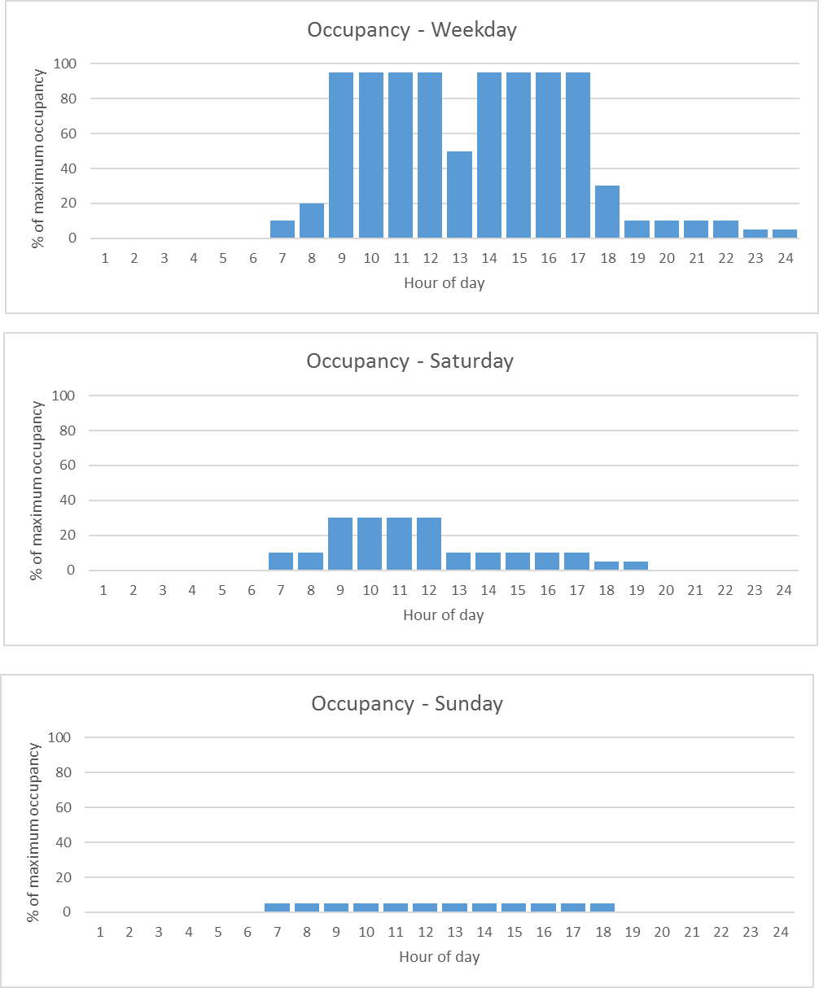
User – Presence profiles (ASHRAE 90.1_G)
Service / Office

Slide 7
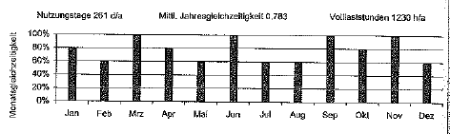
User – Monthly variation (Source SIA 2024)
Office (2-6 Persons)

Slide 8
Equipment – Lighting and auxiliary machines
Equipment such as lighting and auxiliary machines (computers, ovens, cooling boxes) depends on zone type and leads to an electrical and thermal load
Data needed for modelling lighting and auxiliary machines
Load profiles (percentual) depending on zone type → table
Electrical or heat load equipment based on zone type / type of activity → constant, one value in W/m²
Efficiency electrical to thermal for type of equipment → constant, one value
Parameters:
Zone Area
Specific P_{electric /} m² for zone type
Coefficient P_{thermal} from P_{electric}
Coefficient P_{th,rad} from P_{thermal}
Emissivity
P_{th,conv}
P_{th,rad}
Schedule
P_{el}

Slide 9
Internal Gains - Lights
Zone | Heat load | Energy requirement | Source
Office | 500 lx 0.8 m | 25 Wel/m² – Halogen 9 Wel/m² – Flourescent 5 Wel/m² – LED | DIN 18599-10.2 (A2) CommONEnergy2013 (Fig 38, Page 64)
 | 12 Wth/m² | 13 Wel/m² 90% @[WWW1] | Clark2015, Table A2, US
 |  | 47 / 41 / 22 / 13 / 8 Wel/m² | VDI 3807-4, Table 3, (2) GER

Slide 10
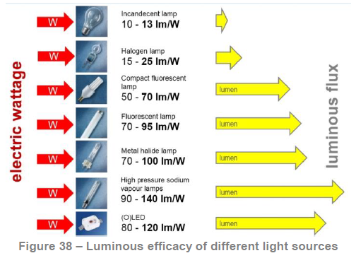
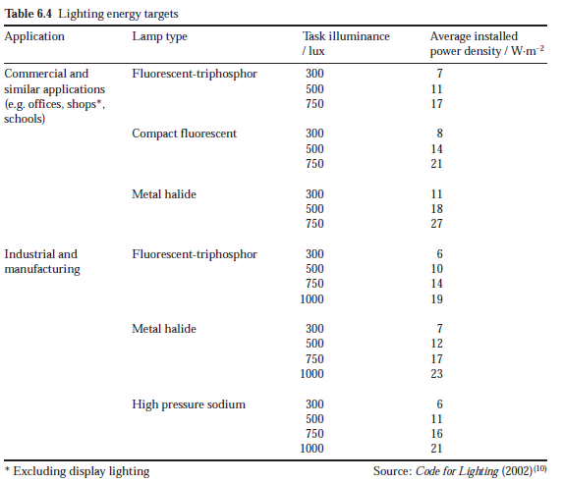
Type of lamps
Source: CommONEnergy
Source: CIBSE, Guide A

Slide 11
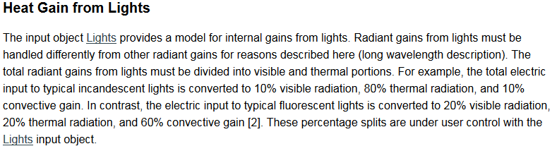
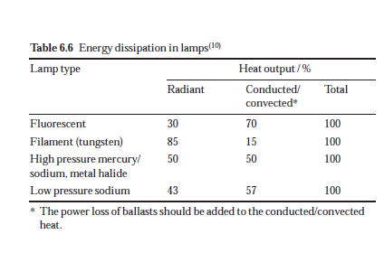
Lighting Efficicnecy
Source [WWW1]
Source: CIBSE, Guide A

Slide 12
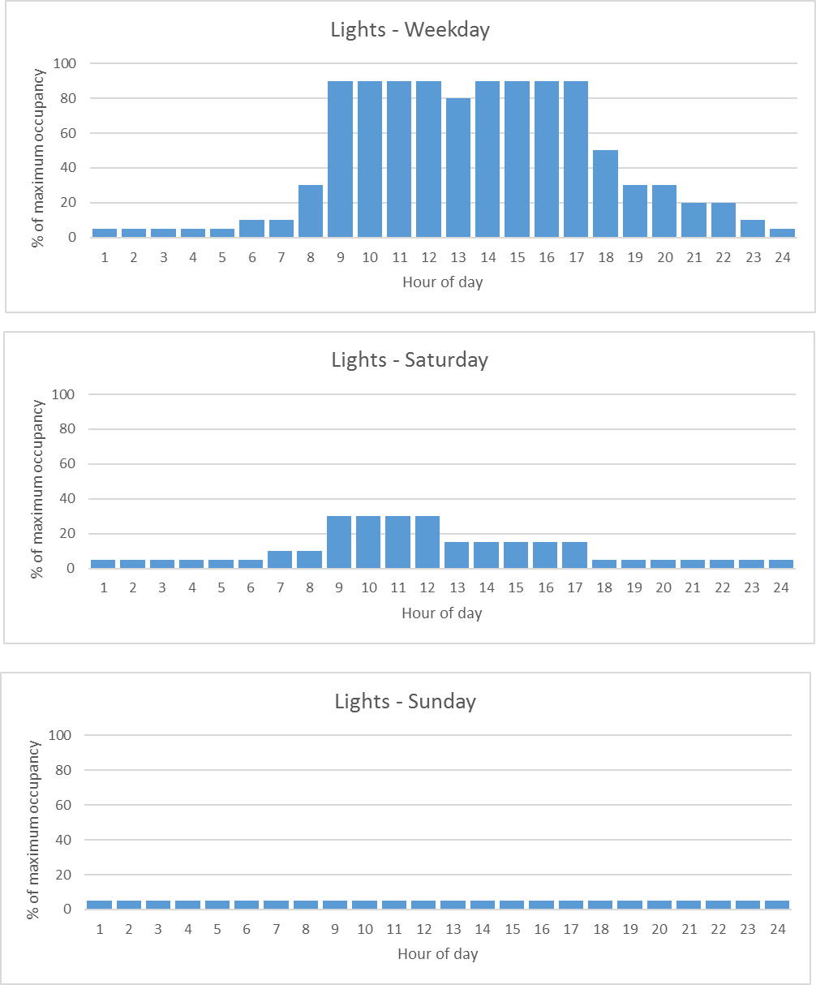
Equipment – Lighting profiles (ASHRAE 90.1_G)
Service / Office

Slide 13
Equipment - Additional heat loads (help energy)
Zone | Heat load | Schedule | Source
Office | 2.8 / 7.1 / 15 W/m² (small, middle, high) | 6 full h / d | DIN 18599-10.2 (A2)

Slide 14
Equipment – Auxiliary Machines
Auxiliary machines (based on [ASHRAE_Fundamentals_2001])
Office – used for office
Heat gain 50% of rated hourly input → 100 % sensible (22% radiant, 78 % convective as a mean between equipment with fans and without fans)
Zone | Heat load | Schedule | Source
Office | 2.8 / 7.1 / 15 W/m² (small, middle, high) | 6 full h / d | DIN 18599-10.2 (A2)

Slide 15
Equipment – Energy system – Temperature and Ventilation, requirements
Zone | Heating / Cooling / Ventilation with outside air
Office (2-6 persons) | 21 °C / 24 °C / 4 m³/(h*m²) DIN 18599-10.2 (A2)

Slide 16
Equipment – Energy System - Efficiency
Type of equipment | Efficiency (available for different years)
Boiler - Gas | Seasonal efficiency 86-95% 102-108% (condensation boiler) Source: [Worm2015]
Heat pump | COP (coefficient of performance): 1.9-4.3 DIN 18599-5, Annex C
Chiller | EER (energy efficiency ratio): 2.9 -5.9 (DIN 18599-7, Table 25)
Air conditioning | EER: 2.6 – 3.4 Heat recovery efficiency: 50% Specific fan power (kW/(m³/s)): 1.5 Source: [Worm2015], DIN 18599-7, Table 6, 29

Slide 17
Literature
[ASHRAE 90.2] - ASHRAE 90.1 - User Manual Appendix G: Building Performance Rating Method, 2004.
[ASHRAE_Fundamentals_2001] - 2001 ASHRAE Fundamentals Handbook (SI), Appliances
[CIBSE, Guide A] - Environmental design, 2006
[Clark2015] – Clark, J. , Energy-Efficient Supermarket Heating, Ventilation, and Air Conditioning in Humid Climates in the United States, Technical Report, NREL/TP-5500-63796, National Renewable Energy Laboratory, Denver, CO, USA March 2015
[CommONEnergy] - CommONEnergy: Re-conceptualize shopping malls from consumerism to energy conservation, D2.2, Deliverable 2.2: Shopping malls inefficiencies, 2015
[DIN 18599] Calculation of the net, final and primary energy demand for heating, cooling, ventilation, domestic hot water and lighting
Part 7: Final energy demand of air-handling and air-conditioning systems for non-residential buildings
Part 10: Boundary conditions of use, climatic data

Slide 18
[SIA2024] - SIA Merkblatt 2024 Standard-Nutzungsbedingungen für die Energie- und Gebäudetechnik, 2006
[VDI3807-4] - Characteristic values of energy and water consumption of buildings Characteristic values for electrical energy, 2008
[Worm2015] – Worm; Rathert, Bekanntmachung der Regeln zur Datenaufnahme und Datenverwendung im Nichtwohngebäudebestand. Bundesministeriums für Wirtschaft und Energie und des Bundesministeriums für Umwelt, Naturschutz, Bau und Reaktorsicherheit, Berlin, Germany, 7.03.2015
[WWW1] - http://bigladdersoftware.com/epx/docs/8-0/engineering-reference/page-089.html → Heat gains from lights

Slide 19
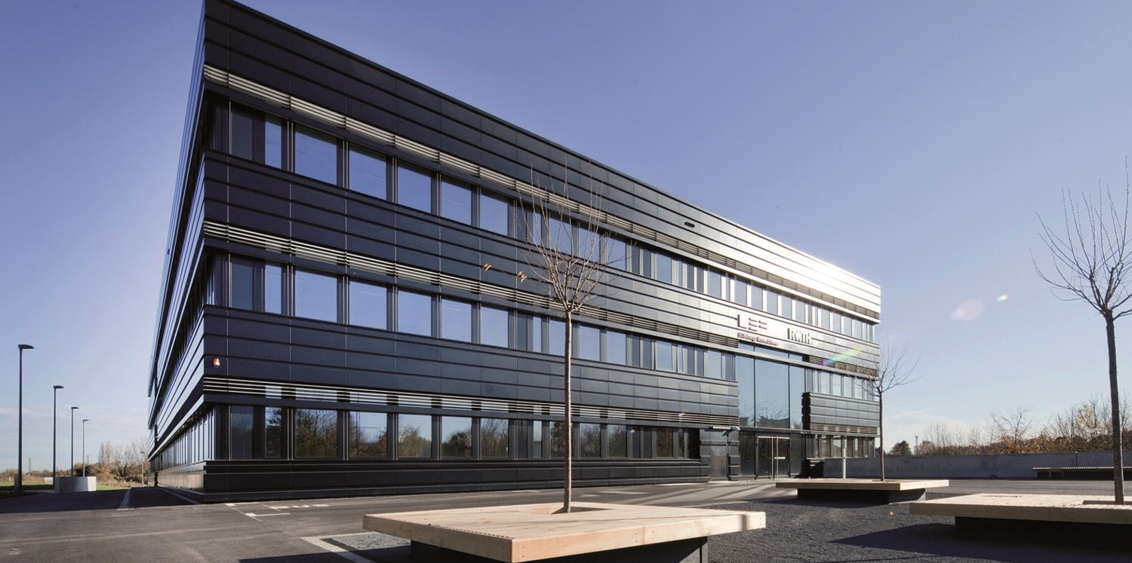
Contact
E.ON Energy Research Center
Mathieustraße 10
52074 Aachen
Germany
FIRST NAME SURNAME
T +49 241 80 49xxx
F +49 241 80 49xxx
xxx@eonerc.rwth-aachen.de
http://www.eonerc.rwth-aachen.de

